Slide 1
Worth the effort? -
The effective design of supplementary video resources for postgraduate academic writing classes
Richard Galletly MBA PGCPP FHEA
Aston University

Slide 2
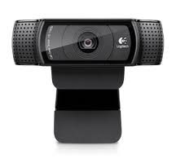
Research project aims:
To identify best practices for optimally effective video resources
To identify new insights for future approaches

Slide 4
Language Box: feedback
“… it's exactly what I would have valued when I was preparing my own PhD
… I will recommend this link to friends and colleagues who are currently teaching or studying.”

Slide 5
Effective video design
A casual approach should be used, to reduce the ‘cognitive load’ (Seery & Donnelly, 2011)
Do not assume too much technical knowledge, so as not to exclude less technically literate students
Professor Bonk -

Slide 6
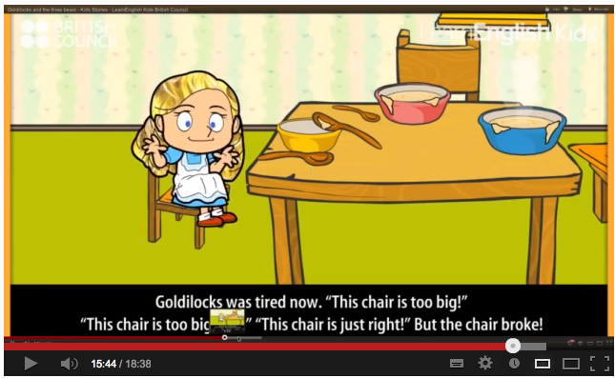
Keep it casual!
Poor materials require a lot of working memory to process them (Seery, 2012)
Online materials should be simple, without clutter – which allows deeper thinking (Seery, 2012); these videos should be kept ‘casual’
Writing Research Proposals -

Slide 7
A new generation of learners
Could these learners be called ‘digital natives’? (Sanchez, 2011)
Can we communicate to them in their language? What works best for them?

Slide 8
Benefits of using recorded video
Educational videos found to increase motivation, enhance comprehension and teacher effectiveness (Holzblatt, 2011)
Emotional aspect to video, a narrative thread, and a connection with the teacher, more than with text

Slide 9
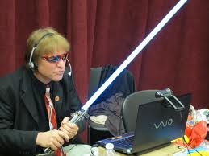
Empathy and authenticity
Showing understanding, empathising with students in the videos, may enhance learning (Choi & Yang, 2011)
Videos allow the teacher to demonstrate a connection with the student, who perceive them as a ‘real person’ (Borup et al., 2012 p201)

Slide 10
Effectiveness of videos
The use of video has a ‘significant positive effect’ on student learning (Fralinger et al., 2009)
Having the option to repeat the lecture helps absorb the content (Giannakos, 2012)
Videos given prior to the lecture will help prepare students for the lecture (Seery & Donnelly, 2011)

Slide 11
The Critical Evaluation Essay

Slide 12
: Feedback

Slide 13
- Sorted by most viewed

Slide 14
4

Slide 17
Sample and data collection
International students of postgraduate business courses at Aston University
61% female
Majority of Asian origin
Ages 21-31
Response rate 25% (92) – but only 40 were in my class, so response rate over 50%

Slide 19
Do respondents expect the video to help?
Students who use technology more are more likely to think these videos will help them later
Those who found the videos engaging were more likely to state that the videos would be helpful writing an assignment later in the course

Slide 20
Students parents’ education
Students with more educated parents less likely to find the videos useful, perhaps they already understand academic writing?
They also found the language in the videos easier to follow – due to English language education? They were less likely to think the videos would help them

Slide 21
Students’ social demographics
Female students found to be more confident using technology, contrary to Heemskerk et al.’s findings (2009)
Older students prefer more information in the videos and were more confident with the language complexity

Slide 22
Is the content too simple, or too confusing?
A simpler design of the videos might make them more inclusive for all students – content should be simplified
Students who preferred ‘just talking’ were less likely to say they would recommend the videos

Slide 23
Asynchronous learning
Students more likely to state they expect the videos to help them later- e.g. when writing dissertations
The majority of students stated that they expect to find the videos more useful for a future assignment

Slide 24
Implications of findings
It may be necessary to design videos with students’ access to and affinity for technology in mind, so as not to exclude those with less understanding for it
Videos should be designed to be casual and engaging, being so complex as to exclude some students
However, those of an educated background may find this approach too simple

Slide 25
Research limitations
Course does not have an assessment- not possible to assess improvements due to videos
Does not take into account asynchronous aspects of learning- how improvements may be made due to use of videos at a later date, for example when writing dissertations

Slide 26
Worth the effort? [yes!]
Promotional benefits for the teacher, and disadvantages
Student feedback overwhelmingly positive, especially for asynchronous use
Students reported that videos might encourage ‘lazy’ students to skip classes (Student 21)
Students increasingly adept with technology – this can be utilised
Changing HE sector: more online courses, so a valuable skill to develop - MOOCs
An opportunity to develop a connection with students outside the classroom

